Slide 1

Respiratory system
Microbiology laboratory section

Slide 2
Throat Swab
Gram Positive Coccus
Staphylococcus Spp.
Streptococcus Spp.

Slide 3
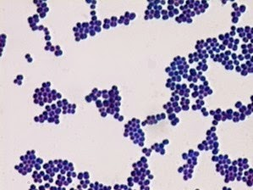
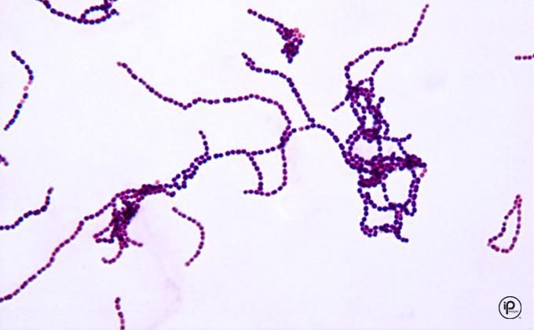
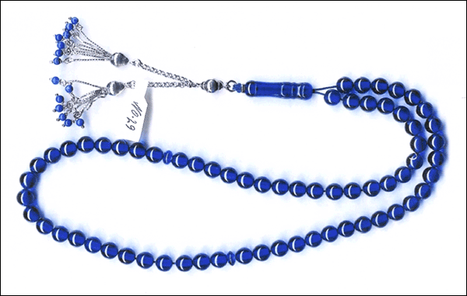

Gram Stain
Staphylococcus
Streptococcus

Slide 4
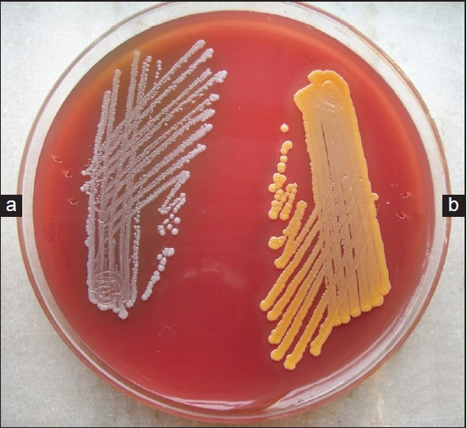
Blood agar
A- staphylococcus .albus
B- staphylococcus.Aureus

Slide 5
Test for differentiation of Staphylococcus species
Catalase test
MSA
Coagulase

Slide 6
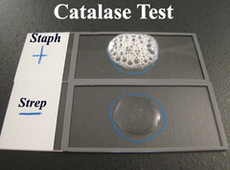
Catalase test

Slide 7
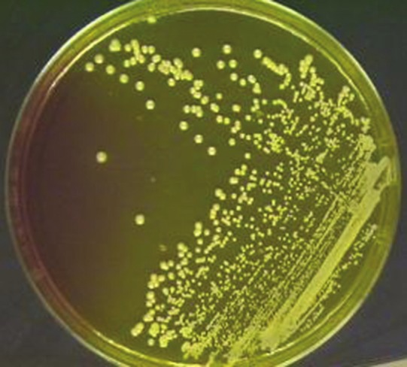
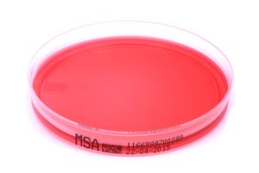
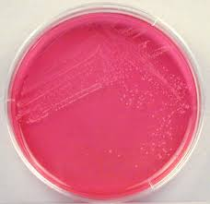
MSA
Mannitol salt agar media
S.aureus
S.albus

Slide 8
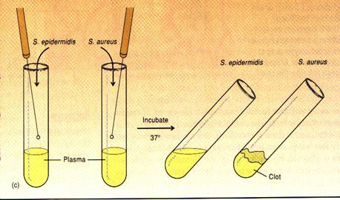
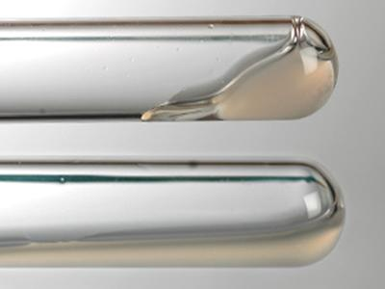
Coagulase test
S.aureus
S.albus

Slide 9
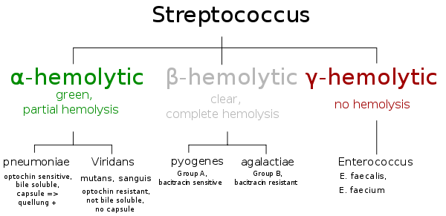

Slide 10
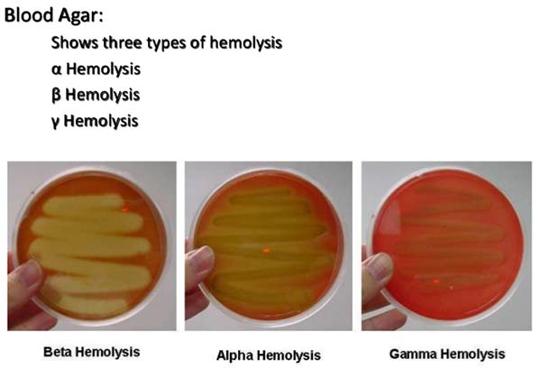
Hemolysis on sheep blood agar

Slide 11
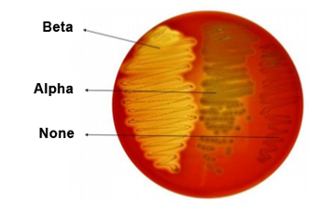

Slide 12
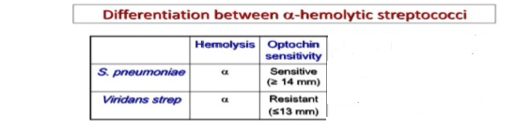

Slide 13
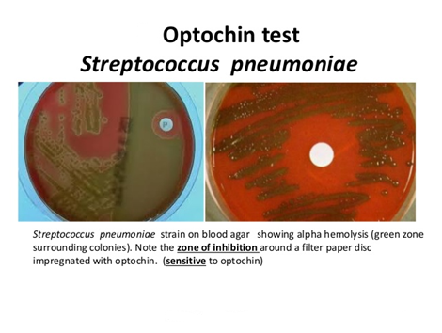
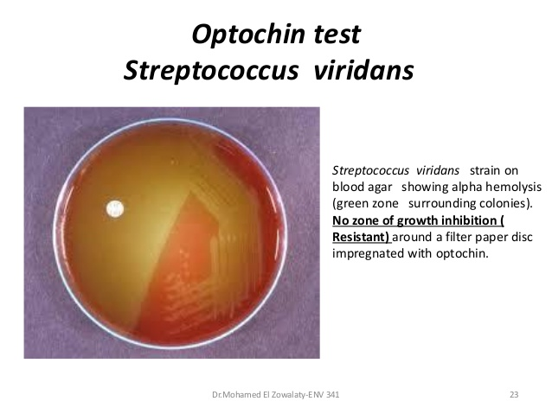

Slide 14
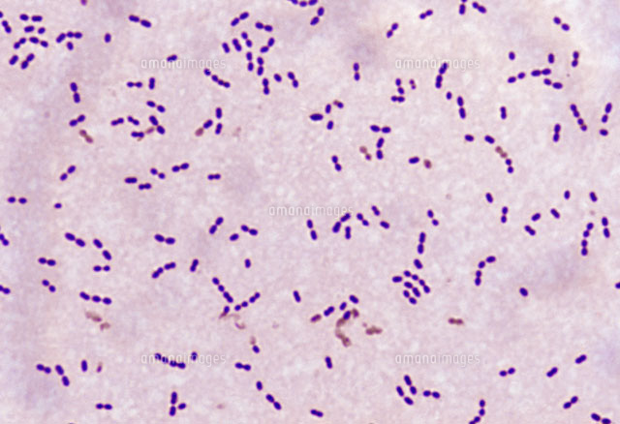
Streptococcus pneumoniae

Slide 15
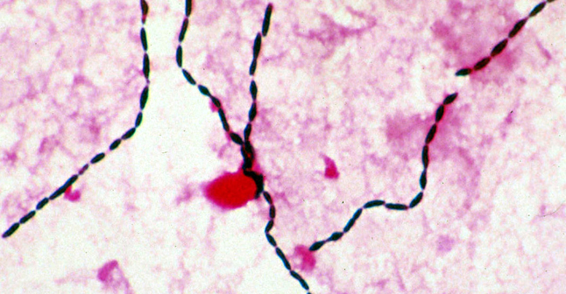
Streptococcus viridans

Slide 16
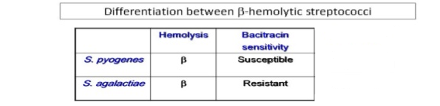

Slide 17
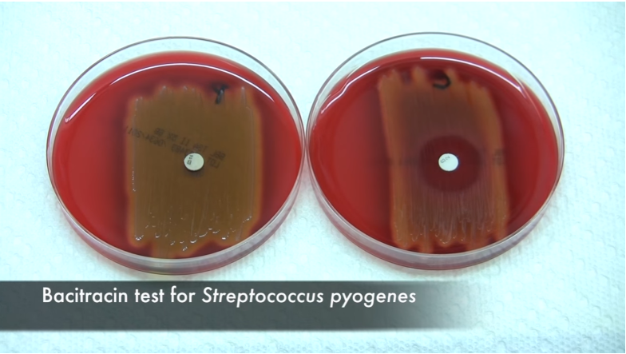

Slide 18
Gamma hemolysis
streptococcus
Enterococcus
Group D
- E.feacalis
Other than Enterococcus group D

Slide 19
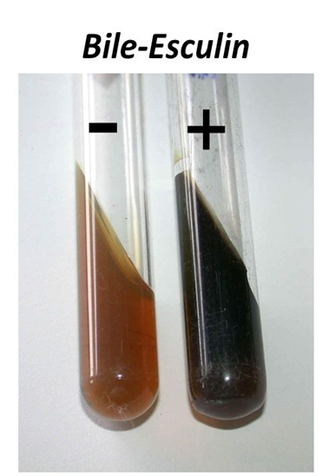

Slide 20
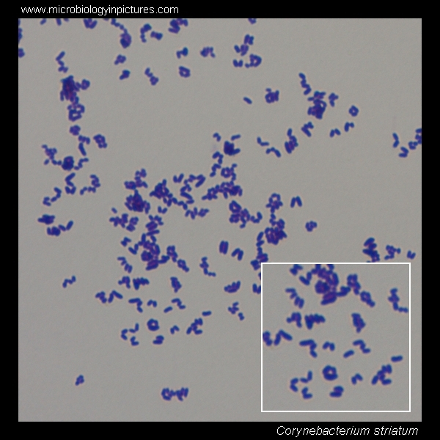

Diphtheroids
Gram Positive
Cocco-bacilli
Arrangement as
Chinese letter

Slide 21
Candida Species
Candida
Spp.
C.albicans
C.tropicalis
C.glabrata
C.Krusei

Slide 22
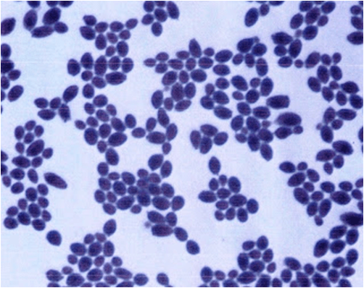
Candida Spp
Larger than Bacteria
Budding

Slide 23
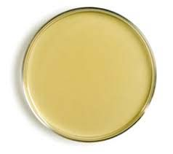
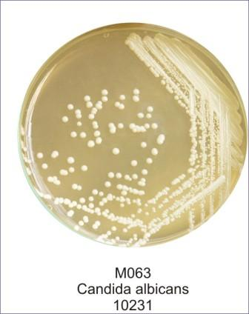
sabouraud dextrose agar

Slide 24
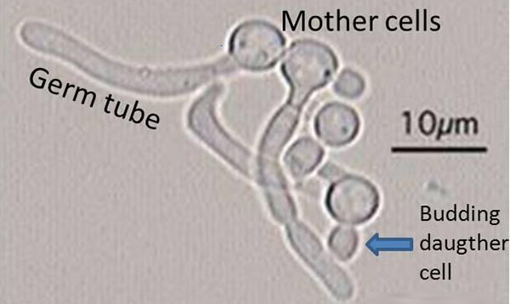
To Differentiate between C.albican and other Species
Germ tube
[ Serum + candida ]

Slide 25
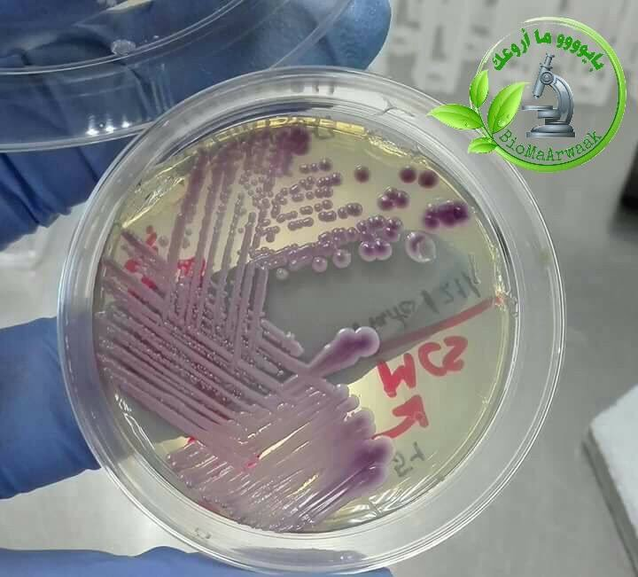
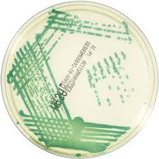
Chrom agar
C.glabrata : violet (dark pink)
glistering
C.albicans : Green

Slide 26
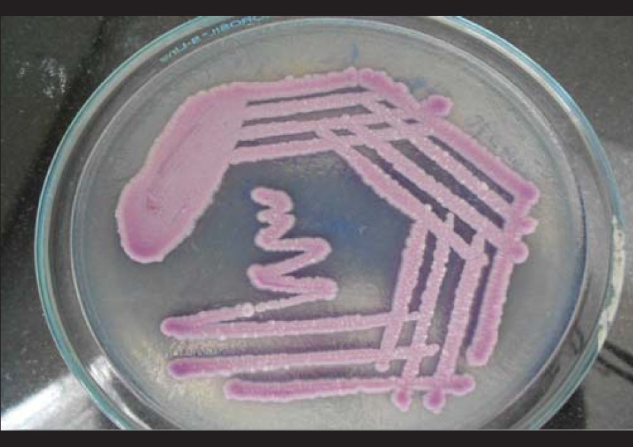
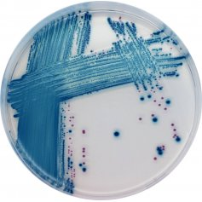
C.Tropicalis Blue
Chrom agar
C.Krusei : rough dry pale pink

Slide 27
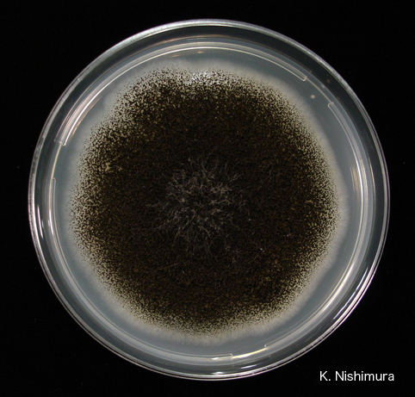
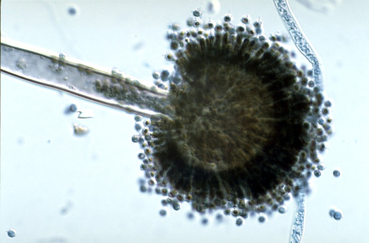
Aspergillus Niger

Slide 28
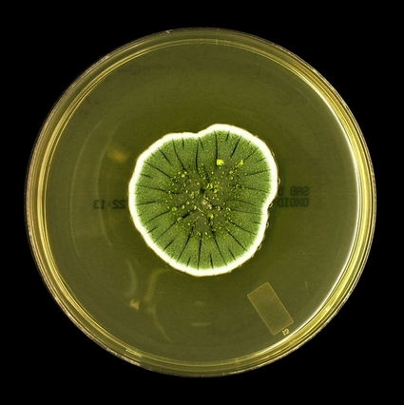
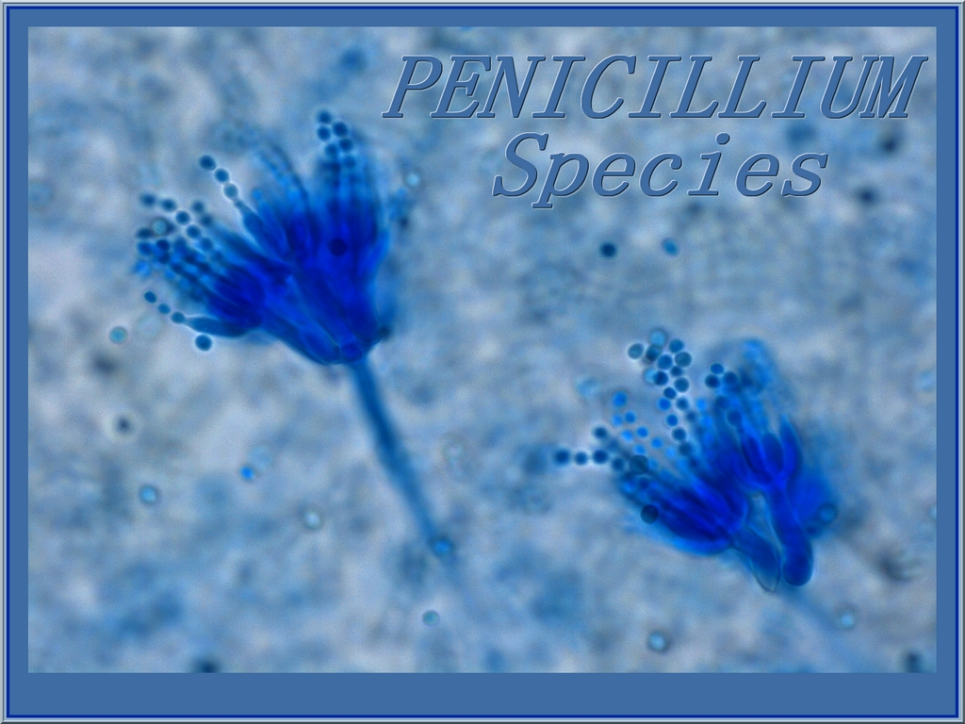
Penicillium Spp.

Slide 29
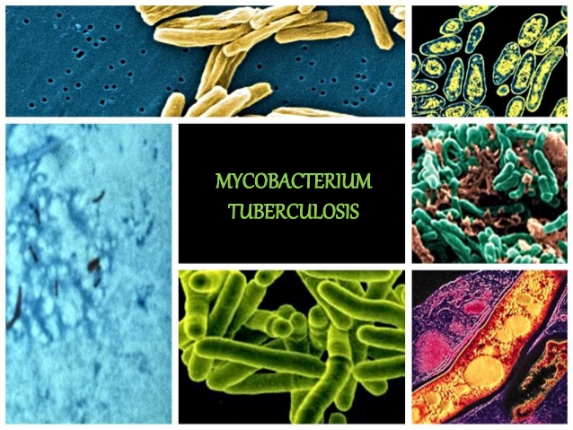

Slide 30
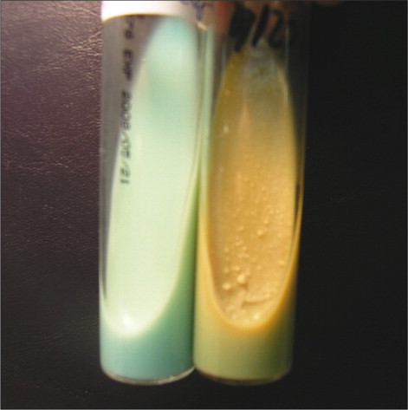
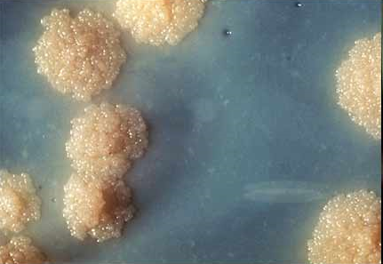
Lowenstein –Jensen Medium
Contain malachite green and egg albumin
Media color : green
Cell show :
Rough
Tough
Buff

Slide 31
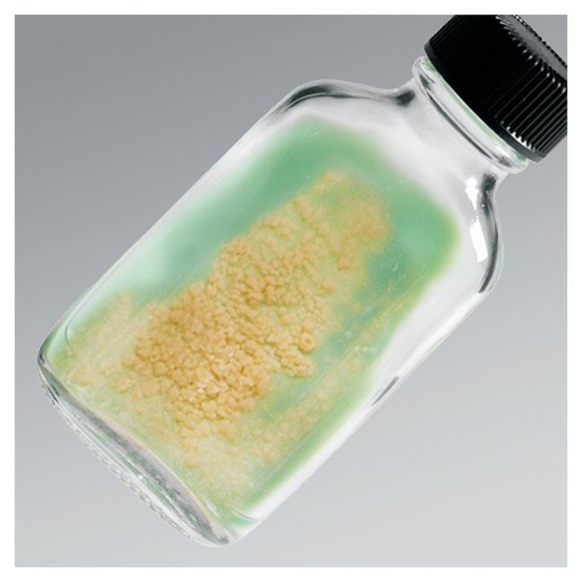
Incubation Period = 4 weeks
Put the media in covered tubes to avoid drying of media

Slide 32
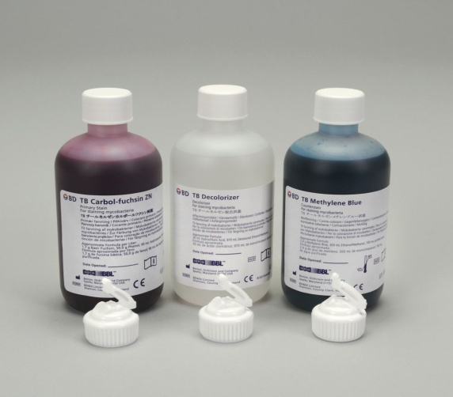
ziehl neelsen
Acid fast stain
Mycobacterium Tuberculosis cell wall are waxed for that reason do heating while staining .
Stain made of :
              Carbol fuchsin
              Hydrochloric acid alcohol ( 3% HCL )
              Methylen blue

Slide 33
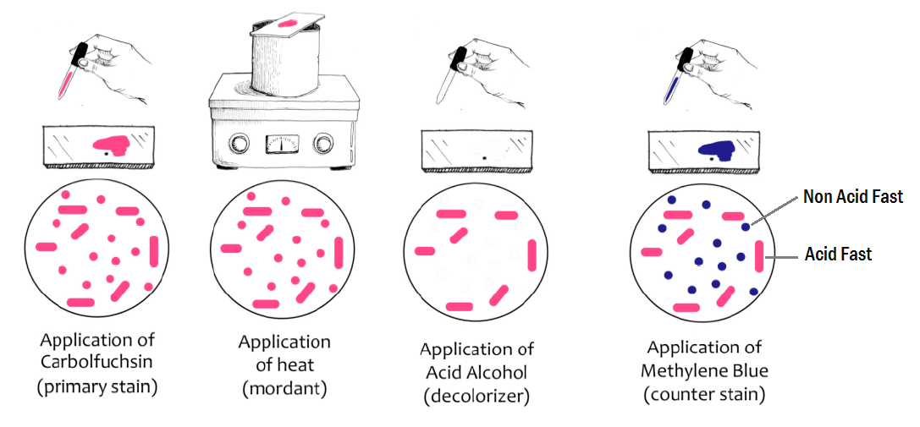

Slide 34
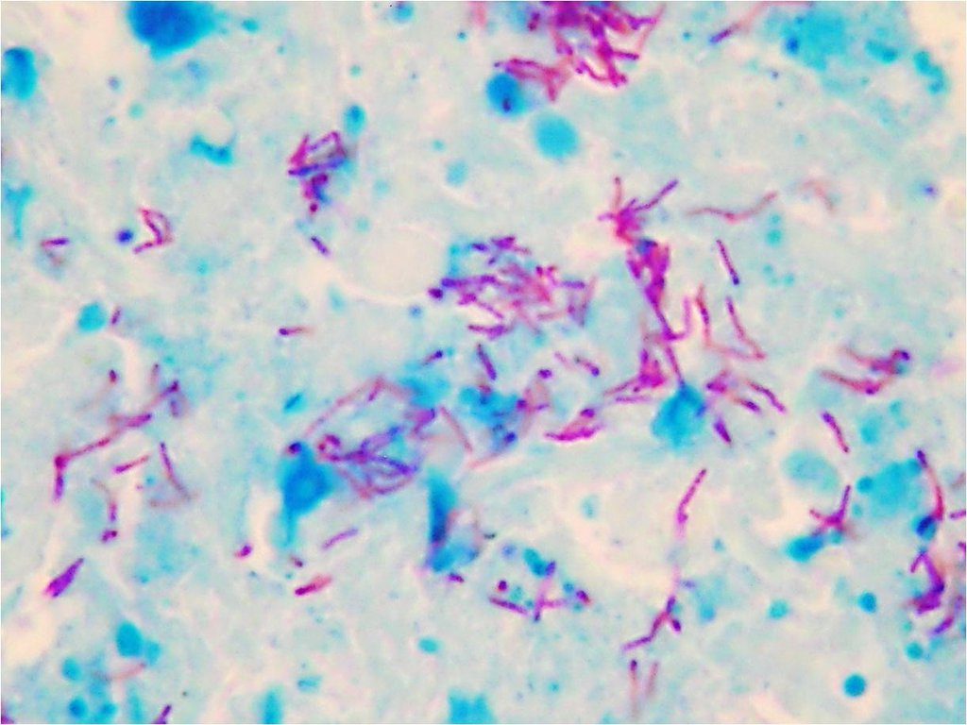
T.B
Acid fast stain

